Slide 1
VMware FT
Lecturer: Ngo Huy Bien
Software Engineering Department
Faculty of Information Technology
VNUHCM - University of Science
Ho Chi Minh City, Vietnam
nhbien@fit.hcmus.edu.vn

Slide 2

Objectives

Slide 3

Contents

Slide 4

References
Daniel J. Scales et al. (2010). The Design of a Practical System for Fault-Tolerant Virtual Machines.

Slide 5
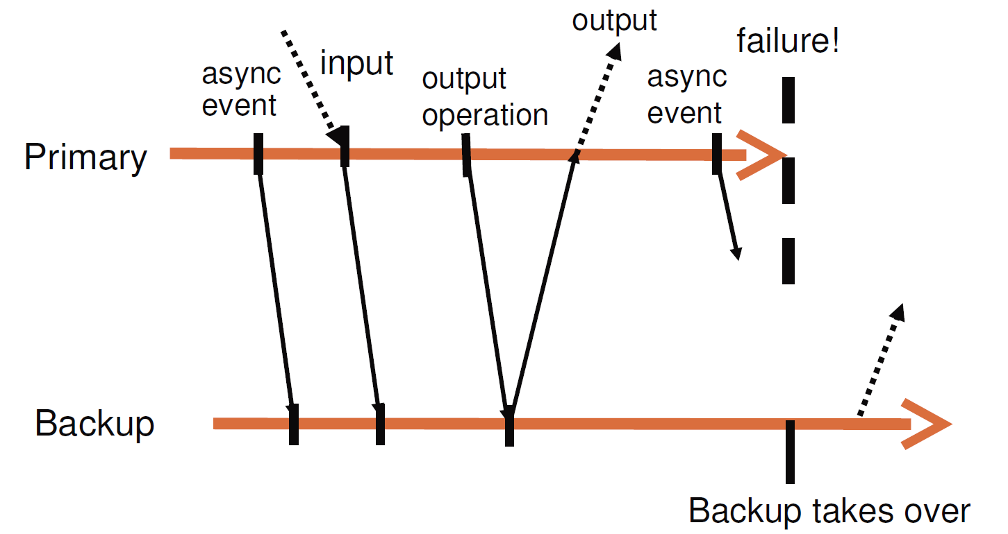
FT Protocol [1] (I)
What happens if the primary fails just after it sends output to the external world?
We cannot guarantee that all outputs are produced exactly once in a failover situation.
Without the use of transactions with two-phase commit when the primary intends to send an output, there is no way that the backup can determine if a primary crashed immediately before or after sending its last output.

Slide 6
FT Protocol (II)
What happens if the primary fails just after it sends output to the external world?
The backup will likely repeat the output after taking over, so that it's generated twice.
This duplication is not a problem for network and disk I/O.
If the output is a network packet, then the receiving client's TCP software will discard the duplicate automatically.
If the output event is a disk I/O, disk I/Os are idempotent (both write the same data to the same location, and there are no intervening I/Os).

Slide 7
FT Protocol (III)
All the sources of randomness are controlled by the hypervisor.

Slide 8

Thank You & See You Again

